Slide 1
BECOMING THE "NIELSEN OF EXPERIENCES” WITH UNIFIED EXPERIENCE DATA
Apr/2023

Slide 2











UNIFIED SYSTEMS & DATA
ACTIVATIONS
TRACE
FIELD MANAGEMENT
LOCATION & EVENT INTELLIGENCE
rTAG
PROJECT
SCOPES
TIME
FEES
RESOURCES
CONTENT
GENERATIVE AI
DAM
APPROVALS
COGNITIVE SERVICES (AI/ML)

Slide 3
TODAY
Momentum gathers meaningful post-event metrics by unifying data from different sources.
Information is either not available or not shared in a timely manner.
This limits Momentums spend and agility when generating insights.

Slide 4
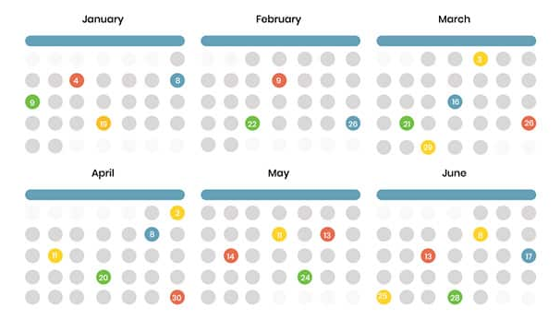













UNIFIED EXPERIENCE DATA ECOSYSTEM
Unified data aggregates data from disparate sources into a single view providing complete and accurate answers to critical questions.
Activation Schedule
Business Leadership
Unified Experience Data
Unified Experience Tracker (UET)
Data Driven Insights
Activation Insights
Event Hub
Inc. Cross Client Benchmarking
Field Team
Conversational Insights
Training & Media
Staffing Agency Integration
Wrap Data
Data Driven Insights
Field Management
Other location & event intelligence
Cognitive Services

Slide 5
TECHNOLOGY OBJECTIVES
Establish a unified data model
Generate a consistent Global Unique Identifier (GUID) for each activation
Create a method to capture all activations. Identifying owners, types, dates, and locations
Generate a master campaign Identifier (Parent ID) and an event date Identifier (Event ID)
Create the ability to integrate post-event metrics from other systems
Create the ability to integrate with event management systems used by Momentum

Slide 6
KEY DELIVERABLES
Unified Experience Tracker (UET) and Input Procedure A front-end Input application and organization-wide process/system for collecting Activation Details and information: Activation Name, Activation Date, Activation Client, and Activation Location.
Unified Experience Datawarehouse & APIs One location for all IDs and data generated from UET. Data models and processes (ETL) to manage changes/updates within UET Centralized data infrastructure that can be enriched with additional IDs and data from other 3rd party systems. Bidirectional APIs to communicate with 3rd party services to send and receive data.
Organization-wide BI/Analytics Dashboard (Experiential Intelligence Dashboard) An accessible and interactive web-hosted dashboard visualizing data from the data warehouse via KPIs and other metrics for Momentum and its clients.
Field Management System A single solution for all field staff to access event information details, training materials and record event recaps.
Activation Calendar Enable visibility into the Momentum activation calendar. Who, what, when and where.
Conversational Insights Leveraging AI to provide conversational insights based on aggregated data. It would provide Momentum with a user-friendly interface to access data and gain valuable insights, though conversion.

Slide 7
UNIFIED EXPERINCE BENEFITS
FEATURE | BENEFIT | PAIN SOLVED
Unified Experience Tracker (UET) | Centralized management of activation data | Scattered and disorganized data across multiple systems
Master campaign Identifier & event date Identifier | Unique identifiers for each campaign and each day of the event | Enabling the data team the ability to start work with greater agility
Unified Database | Consolidated data storage | Redundancy and inconsistency in data storage
Activation Calendar | Easy visualization of scheduled events | Inefficient event planning and tracking
Client Power BI Dashboards | Customizable data visualization for clients | Limited client access to data and insights
Field System | Single system for all field related data to live. Who worked the events, what materials do they need for training, and what happened during activations. | Inconsistent and disorganized data being recorded per event from field teams.
API Integration | Seamless communication with field management systems Real-time data updates across UET and field management systems | Manual data transfer and synchronization Inconsistent data between systems

Slide 8
WHERE IS THE DATA?
To realize Momentum's ambition of becoming the "Nielsen of Experiences," it is essential to implement a unified data strategy and establish robust data governance. Creating a unified data model with both structured and unstructured data requires careful planning, organization, and analysis, to result in more valuable insights and a better understanding of complex data.

Slide 9
TECHNOLOGY GOAL: UNIFIED DATA
To implement a unified data solution that integrates data from disparate sources into a single view, providing accurate answers to critical questions.
A standardized and repeatable process is required for scheduling and recording event dates and details within a master activation calendar, applicable to all clients.
The implementation of this technology solution will allow for a streamlined process of data aggregation and provide a centralized location for all connected data.
With this technology, Momentum and Its clients can make informed decisions based on accurate and complete data, ultimately leading to better business outcomes.

Slide 10
UNIFIED EXPERIENCE DATA ECOSYSTEM
Unified data aggregates data from disparate sources into a single view providing complete and accurate answers to critical questions.
Activation Schedule
Unified Experience Tracker (UET) and Input Procedure A front-end Input application and organization-wide process/system for collecting Activation Details and information: Activation Name, Activation Date, Activation Client, and Activation Location.
Unified Experience Data
Activation Insights
Field Management Portfolio-wide standardized system for managing event details, assets, and on-site wrap information. It includes a cloud/web-based tool accessible from anywhere for real-time updates and version control, eliminating the need for multiple spreadsheets.
Conversational Insights
Cognitive Services

Slide 11
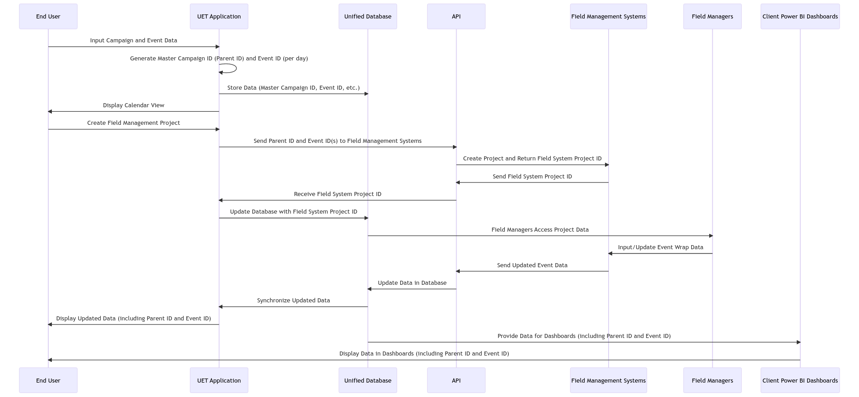
UNIFIED EXPERINCE DATA FLOW

Slide 12
LOOKING AHEAD: "Nielsen of Experience" beyond Unified Data Model
PHASE 1 Unified Event Data | PHASE 2 Product | PHASE 3 Commercial Pricing
Continued ingestion of both our current client and MOMO proprietary event data Standardized ingestion models – api, 3rd party data sources, tagging/flagging Storage Cognitive Services/ queries | Ingest new client data (even clients we don’t do events for) – use of standard method as well as data transformation required Compare client data to our event data by category – outside/inside, sports, music etc. , timing, weather Generate reports – trends, benchmark comparisons, “We Know” series etc. Dashboards of client data with some benchmarks/comparison flags by category | Ingestion Pricing – one time & ongoing, use of API Category inclusion Pricing for comparison (do some cost more?) Custom report Pricing for deeper dives into your data and the comparison to our data set Dashboard creation/access Pricing with licensing/seat access

Slide 13
FIELD MANAGEMENT

Slide 14
GOAL
Identify a field management cloud platform that can manage event details, assets, and training material and collect post-event wrap information.

Slide 15
KEY REQUIREMENTS
FEATURE | DESCRIPTION
Dashboard View | A wrap up view for BL to see all scheduled, in progress, or recapped events.
Calendar | A view of all ongoing or recapped events.
Bi-Directional API | Ability to ingest GUID (and any updates to name, location, program etc) as well as POST data to Momentum BI.
Mobile optimized for field staff | Mobile phone friendly (native app or web app) for field staff to record data from their phones.
Attachments for Event | Momentum to upload training documents, troubleshooting guides, directions to site location, etc—easily accessible for field staff.
Offline Data Entry | Option to push data to live if network connection is unstable.
Media Upload and Tagging | Video and photo upload—Momentum can tag photos/rate photos to easily use for client reports.
SMS Event Reminders | Push notifications for field staff to work or recap events.
Recap Notifications | Reminders to recap events (field staff).
Review Recap Reports prior to submitting | Recap data will not push to Momo BI unless "approved" by Momentum staff.

Slide 16
FIELD MARKETING PLATFORM ANALYSIS

Slide 17
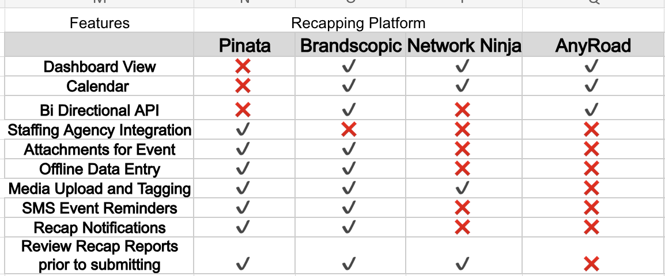
FIELD MARKETING FEATURES
Top 3 Platforms + AnyRoad that meet the requirements of both Verizon and overall Momentum needs.

Slide 18
FIELD MARKETING - COMPARISON
 | Pinata | Brandscopic | Network Ninja | AnyRoad
STRENGTHS
Definition | Easy to use, attractive platform with the ability to onboard and integrate with staffing agencies for robust field marketing recaps | Simple, no frills UI, gathers field marketing recaps from teams and organizes the data into one platform that will easily transfer data to MOMO BI | Field marketing recapping, asset management system. Has many custom features that require custom builds and money to create and test. | Primarily supports ticketed events and shows the consumer journey once a ticket to an event is purchased. Can support QR code creation, registrations and surveying but does not allow for field marketing recaps and users within the system.
Superior Qualities | Attractive UI | Very Simple | Robust Scheduling | Ticketed event support
Core Competencies | Staffing Agency Integration | Bi-Directional API | Emailed custom reports | Post event sales
Technological Advancement | Offline Data Capture | Offline Data Capture | Custom Report builder | Ticket purchasing
WEAKNESSES
Incompetencies | No API | Basic Interface | Difficult to Navigate | No qualitive data
Areas of Improvement | No dashboard | Overall UI | Learning Curve | Add field staff users and dashboard
Obstacles | Most Expensive | Small Support Team | Load Lag | No field marketing users/recaps

Slide 19
COST COMPARISON
Brandscopic: Unlimited users for all admin, client, or field staff user seats
Brandscopic: Cap at 3k event hours per month: equivalent of 300 events per month. each 10 hours long
Pinata: $49 / user; no volume discounts
Network Ninja: the most cost-effective but will come with the least features
 | Brandscopic | Pinata | Network Ninja
/year | $12,000 /year | $30,398/year | $12,000 / year, unlimited tasks and events
/month | $1,000.00 | $1,666.00 | $1,000.00
details | Event Hours per month: 3k | 100 tasks per month | unlimited users and events
users | Unlimited users | 40 users / $49/ USER | Unlimited

Slide 20
NEXT STEPS
Technology
Develop an Activations Application
Design the Experiential Atomic Data Model architecture
Deploy Brand Brandscopic for Verzion
Bethany
Audit of each client account, what each account is measuring and in what format.
Analysis of why event information is hard to obtain and keep accurate.
Plan course correction and identification of information owners.

Slide 21
NEXT STEPS
Momentum Data Discovery
Audit all data capture but the client team
What do we have?
What is the source?
What is the cadence?
What is captured manually by a field team?
Technical Discovery UED
Detailed requirements document
High-level solution architecture
API definitions
DB design
Front-end Mockup
Field Management: BrandScopic
Vendor Set Up, security & sign SOW
Design a deployment plan
Process and training material
Load test use case
Placer POC
Data extraction
API design calculating the number of calls
Document insights gathered

Slide 22
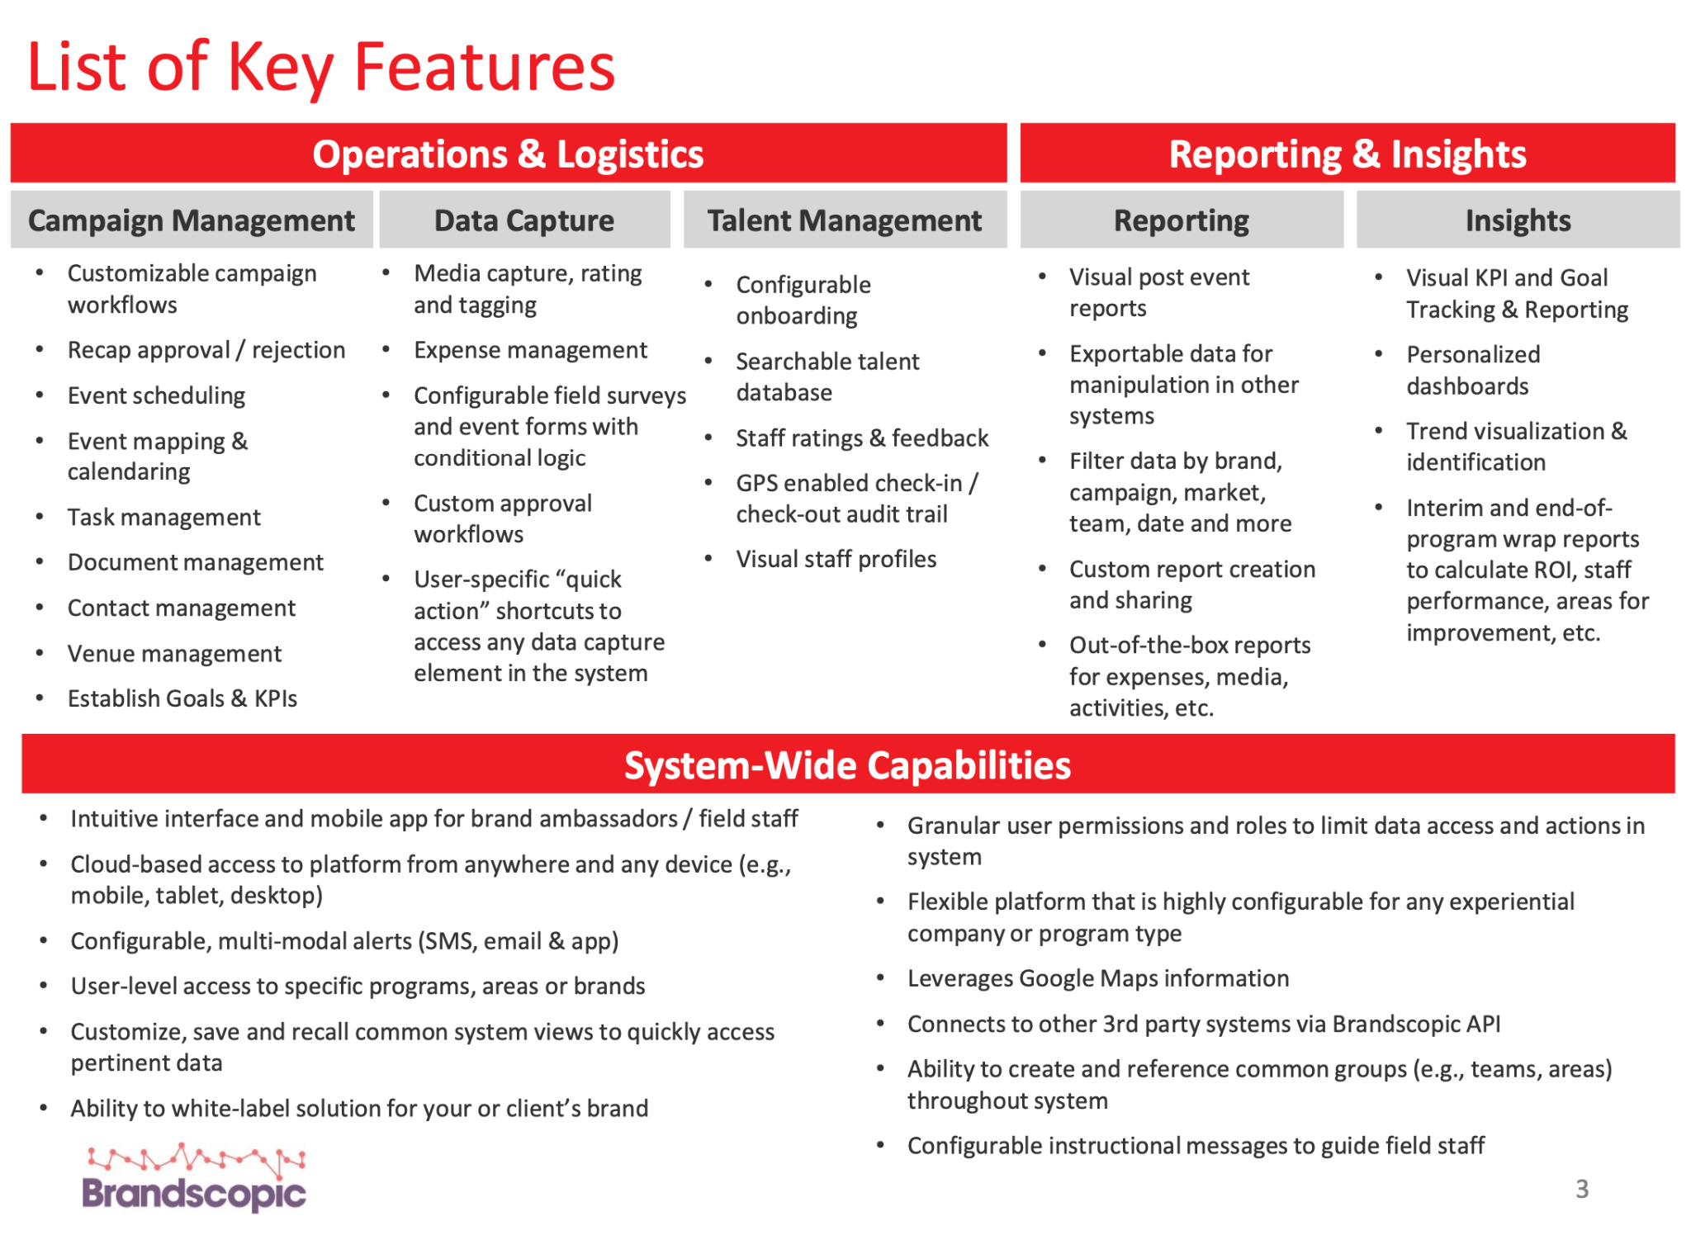
BRANDSCOPIC: LEADING PLATFORM

Slide 23
NEAR TERM VS LONG TERM FIELD MARKETING

Slide 24
VERIZON X MOMO ORGANIZATIONAL DATA SYSTEM​
Verizon Experiential Intelligence Dashboard:
Measurement of all Verizon experiences
Automated processes and data ingestion
Real-time Dashboard/Data accessible by non-analytic business users
Portfolio-wide system:
Booking and planning “events.”
Managing Event Details, Changes, Updates, and Assets/Items required for events
Collecting on-site information through a cloud platform/web-based tool
Updatable by anyone with access from anywhere with built-in version control
Mitigate: 10 different data sources with the same and possibly conflicting manually collected information

Slide 25
UNIFIED DATA + FIELD MANAGEMENT What we need to get there (Components)
Momentum owned and developed Cloud Database for storage and sandbox (VZDB1 Azure DB)
Direct Data Pipeline development with ALL VZ Experiential Datasources:
Master Calendar/Schedule of Events and Event Details
Common Backend
QR Tiger
Qualtrics (Survey)
Verizon Adobe Analytics Files
BA/BL/FM Collected manual on-site information
SOP/System of Processes and cadence for Data Governance, Auditing, and regular maintenance and QA
Schedule for datasource updates
Event Management Platform/Front End Tool for collecting manual information
Accessible via mobile
Momentum controlled users and permissions
Customizable fields encompassing all events
Built in reminders and schedule for missing fields/recaps for past events
Calendar view
API data pipeline

Slide 26
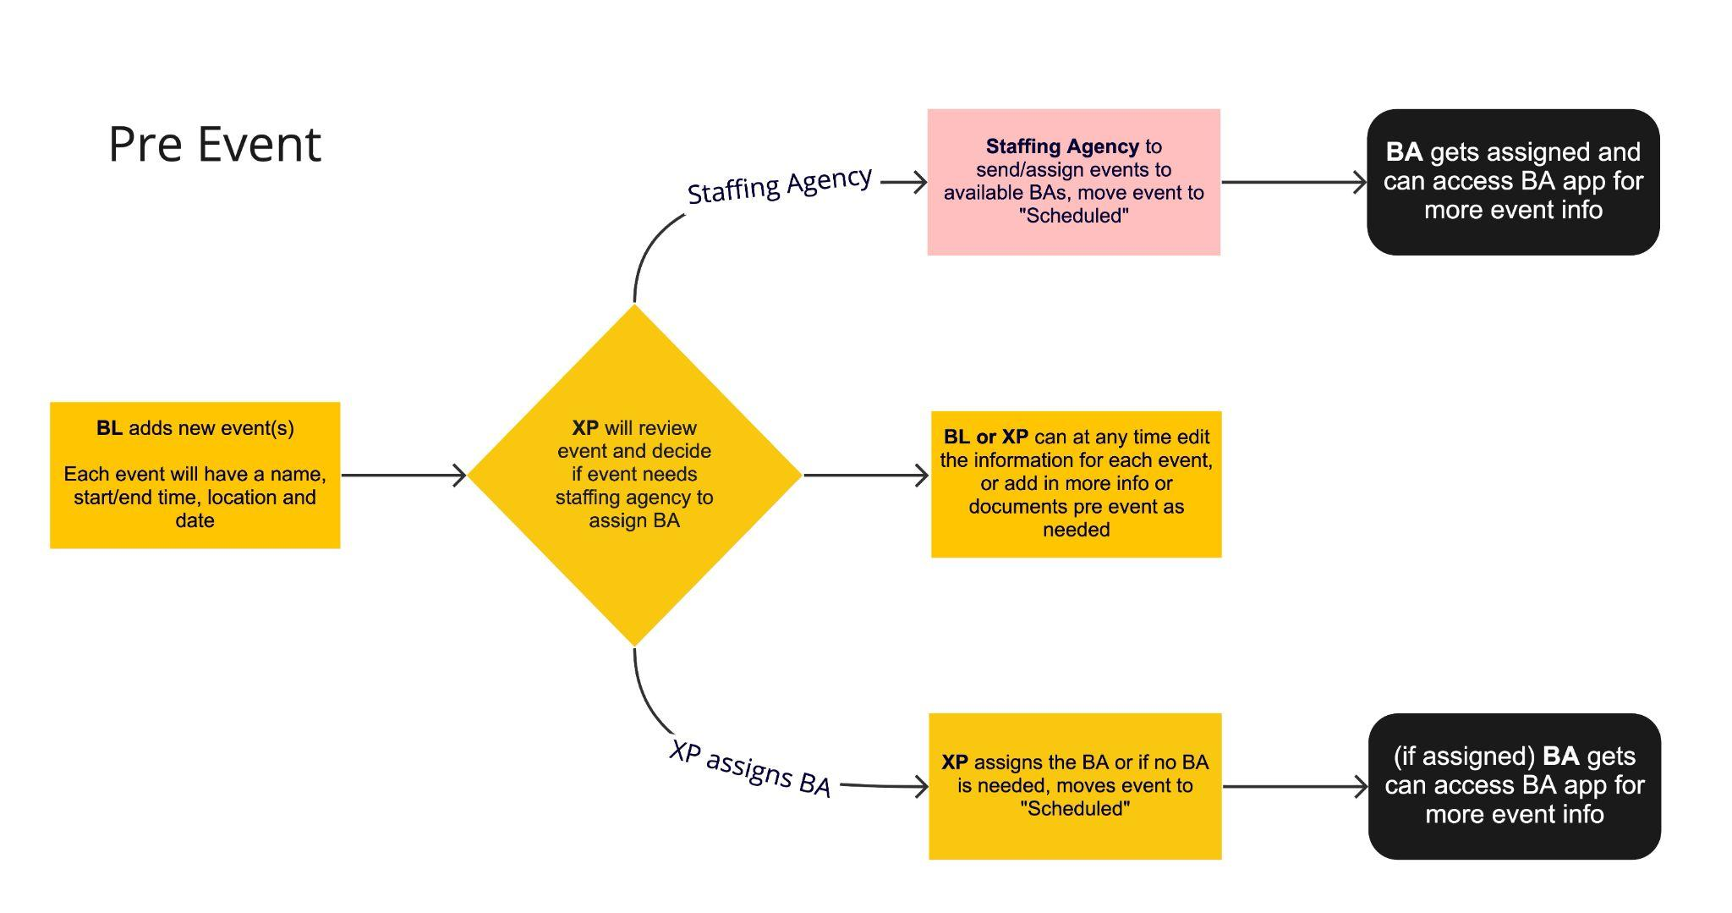
FM USER JOURNEY: PRE EVENT

Slide 27
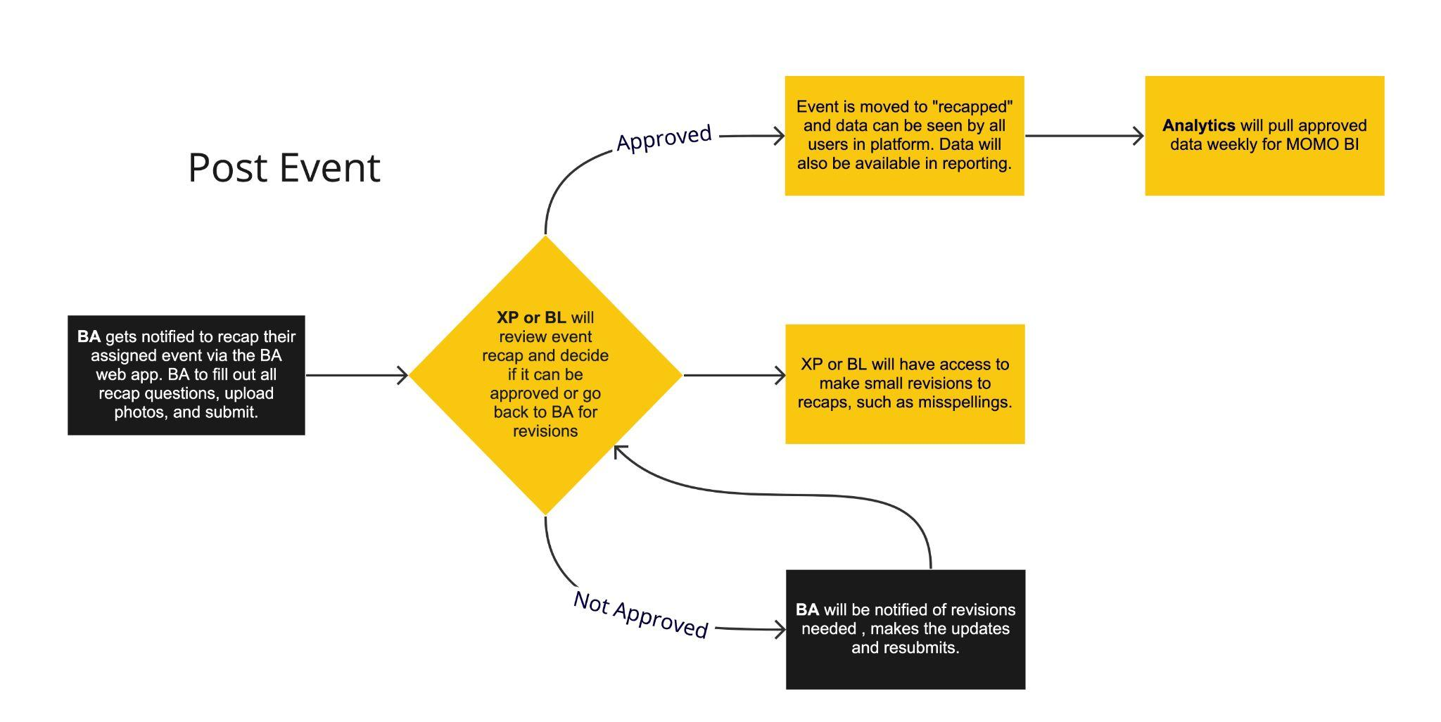
FM USER JOURNEY: POST EVENT
Once the event is complete
BAs recap events
Data approval
Data available in MOMO BI

Slide 28
OTHER FIELD MANAGEMENT SYSTEMS

Slide 29
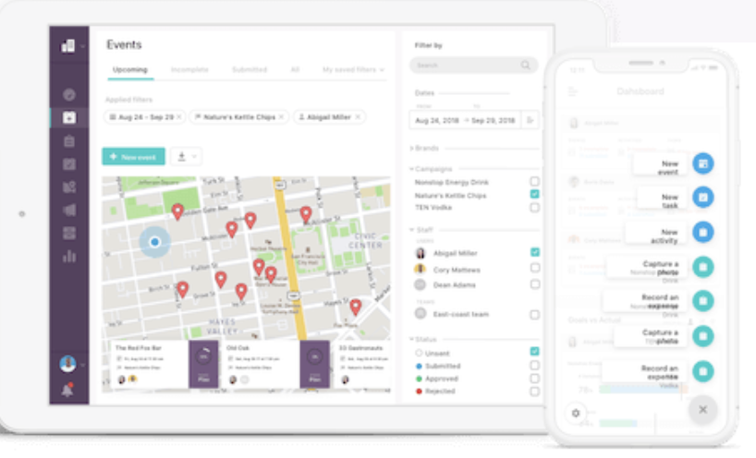
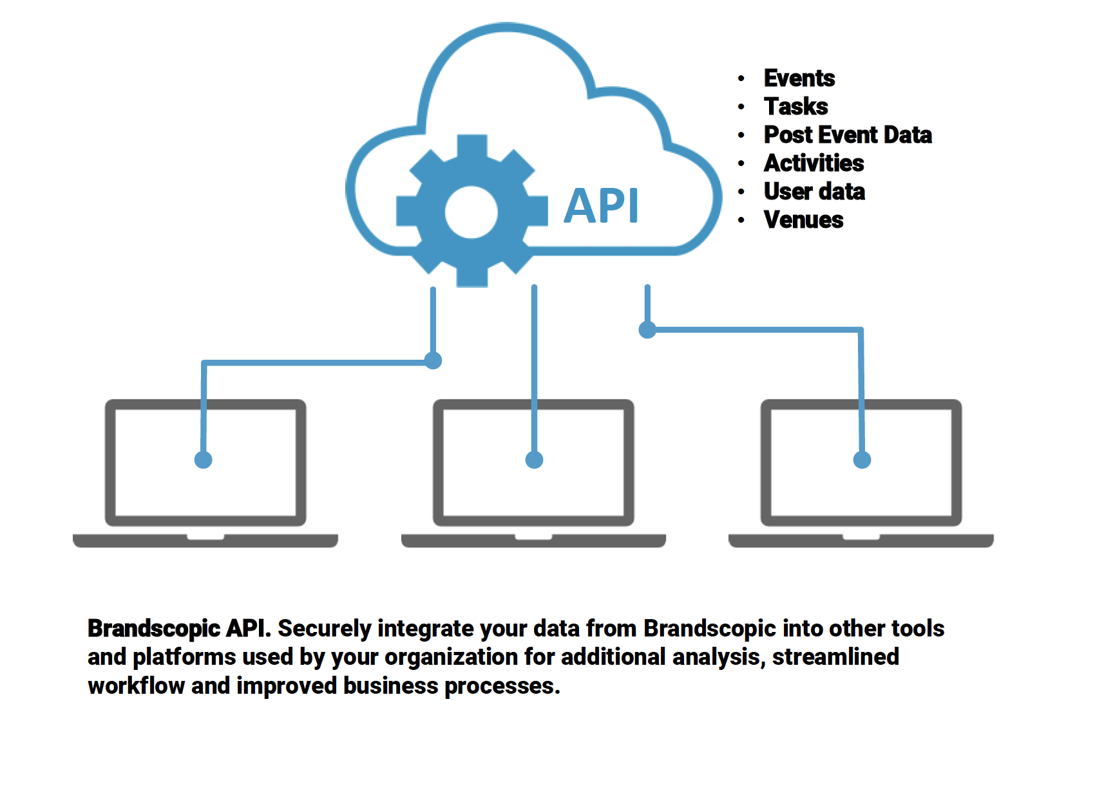
Brandscopic
Mobile App or Responsive web app
Can custom build according to our need
Configurable dashboard
Notifications, in app, sms or email
Calendar view by event, campaign or phase
Geo locate for BA or FM check in (geolocate crumbs or IP address)
Bi directional API
Staffing agencies can have accounts and then assign staff
Can partition the client portals so that Momentum would have 1 portal but multiple clients; no data overlapping

Slide 30
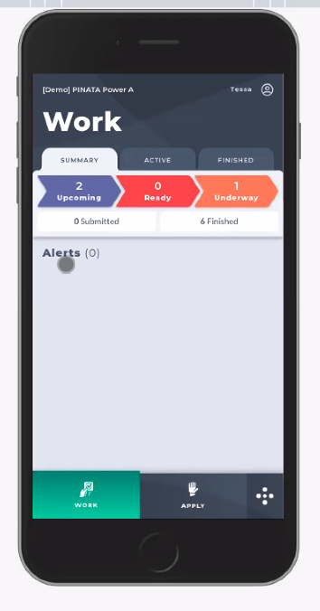
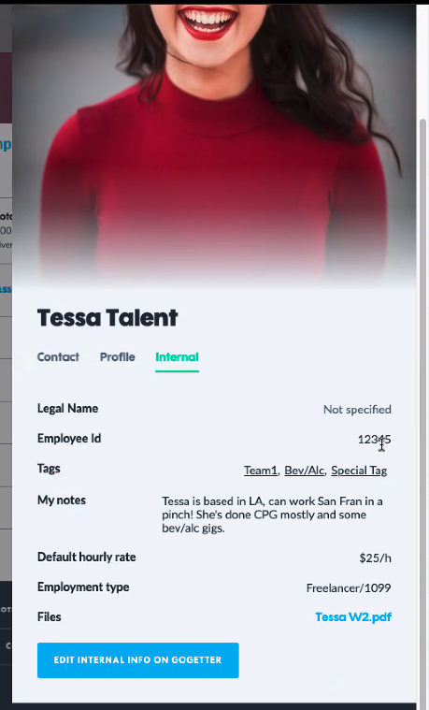
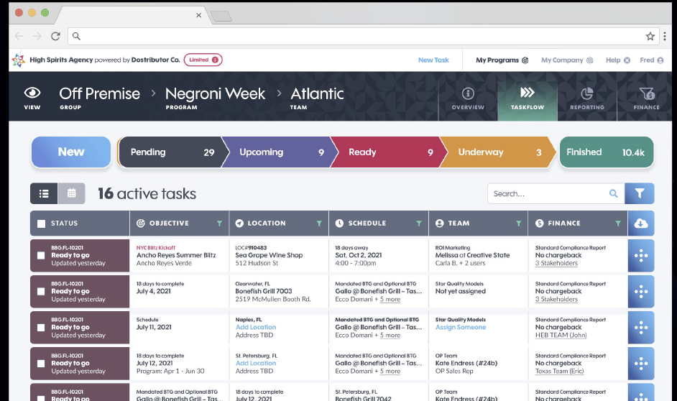
Pinata
PINATA will onboard staffing agencies so that they can assign or request BAs for events
Locations integration w/ google, locations can upload and save easily, can upload maps to get to the actual event space for the BA
Can assign multiple user groups to the events when assigning
BAs create profiles w/ photos, shirt size, email, etc
Can manage $$ profiles and attach it to profile in admin also add tags
BA app is web based
Text 30 min before to “log in”; log in gives all upcoming activity for that BA only
Check in w/ geo locate; can check out and do the recap post or during.
Review reports prior to them being visible (clients can’t see until approved)-- can edit reports in admin for small edits or send back to BA

Slide 31
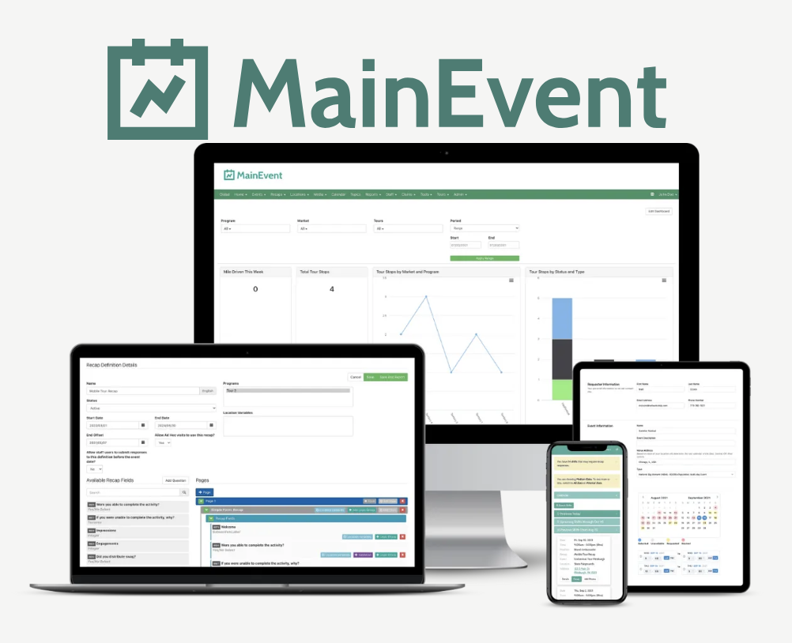
Network Ninja
Functionality has not improved or updated in the last few years
Can easily take an API out to Momentum Analytics dashboard
BA recapping app, able to only see events they are assigned to and recap them
Has a overall calendar but it is not by any means easy to filter or sort
Keeps all of events in a spreadsheet form but often is a long load time once you get more and more events
Note: We are using MainEvent for Constellation activation data capture across about 22 markets, for approximately 3K events

Slide 32
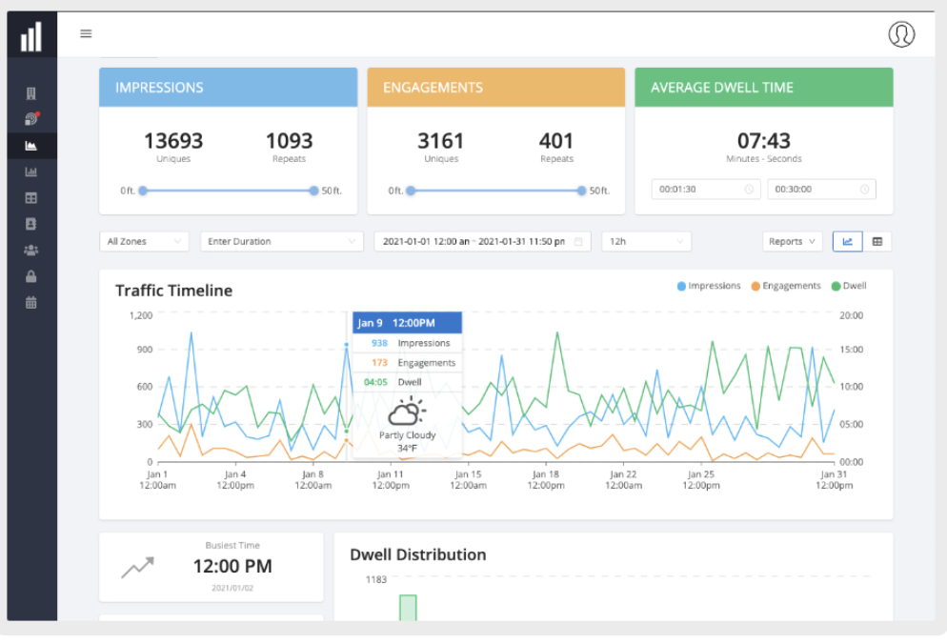
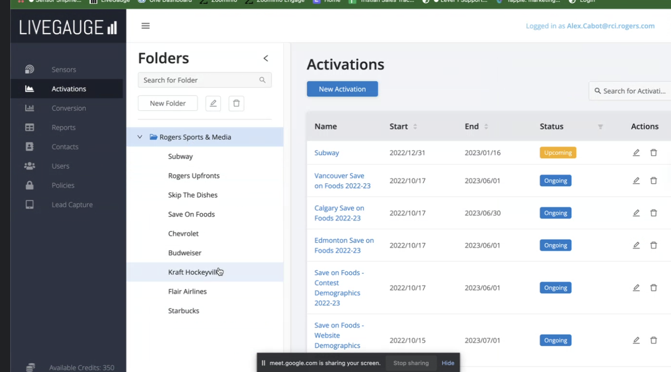
LIVEGAUGE
Reco’d by our Canada MOMO office
Based on location = we get weather data, other event data, and demographic data
Smart qr codes
Logic, data points
Demographic data, can tie these qr codes back to the event they are being used at
They don't have a calendar
Can do an export of events in a timeframe
They do have sensor devices like mesh, which can be tied back to the events as well but those aren’t mandatory to use. Devices can collect data offline.
Link on browser for BA’s to recap, they will only have access to recap/upload photos
Cost is TBD– they are sending a MSA, can do month to month billing

Slide 33
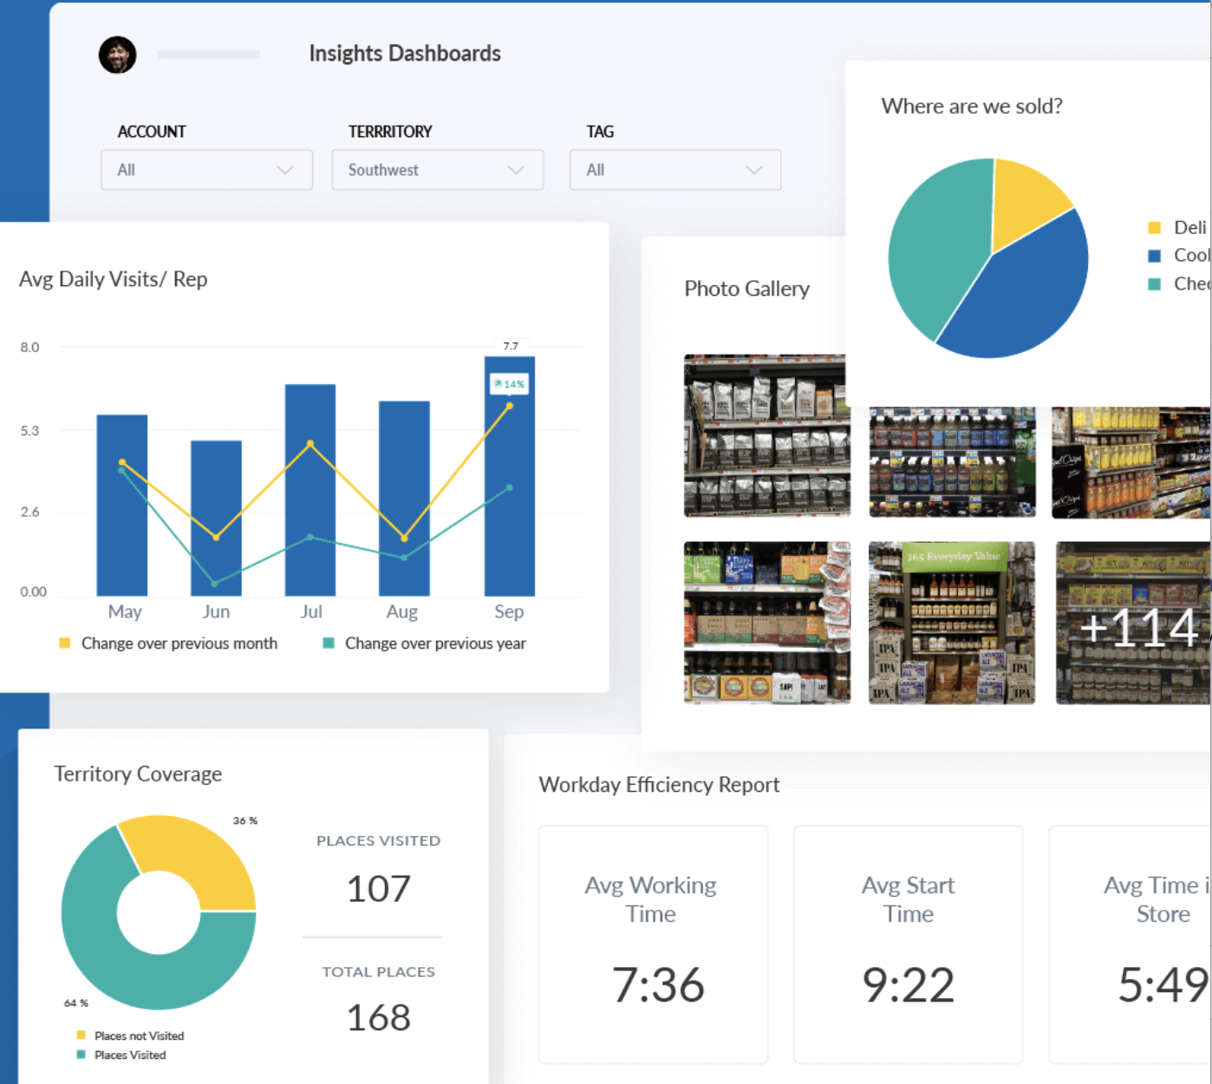
Repsly
Scheduling based on store visits and routes and scheduling
Typically used for stocking at stores, demos, etc.
Add locations - load the location with just a name w/out full address
Representatives - add in the field team members and you can have a monthly schedule
Drag and drop scheduling feature on the calendar– can change the dates easily
Alert sent to account manager if its not completed via email
Can save as a draft throughout the event and can work offline
Tag photo feature, allows clients to log in and see photos via hashtag
COST: $28,500 / 50 users (25k per year; $3,500 for initial set up)

Slide 34
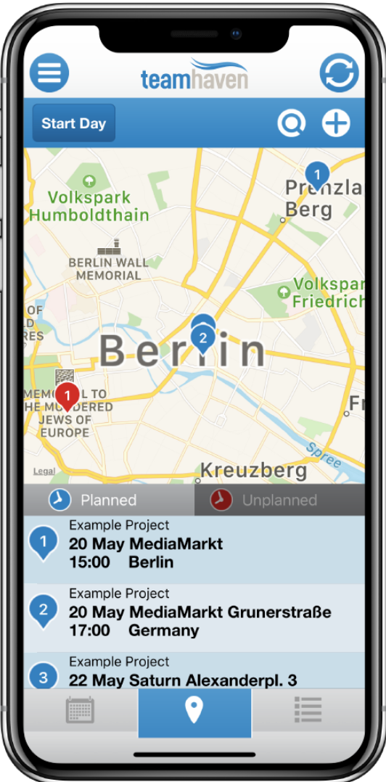
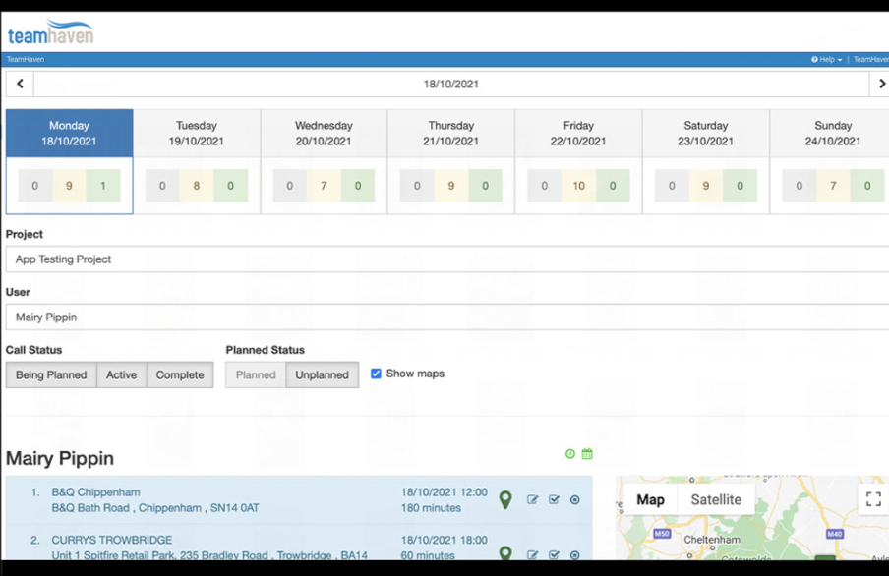
Teamhaven
In house software built for a field marketing agencies
Mobile app, just for the data collection, works offline
Web version is for admins and setting up the events
Very very old school UI
Design the survey unique to each tour
Geofencing check in
Can integrate with PowerBI
Two methods of getting data into PowerBi
Lock people by certain geographic/agencies
ISO certified, GDPR compliant
Push notifications daily for reminders
COST: Dependent on usage.
Billing based on actual events executed, not by users and no setup fee
Designed so you can build the cost of the software into the project costs

Slide 35
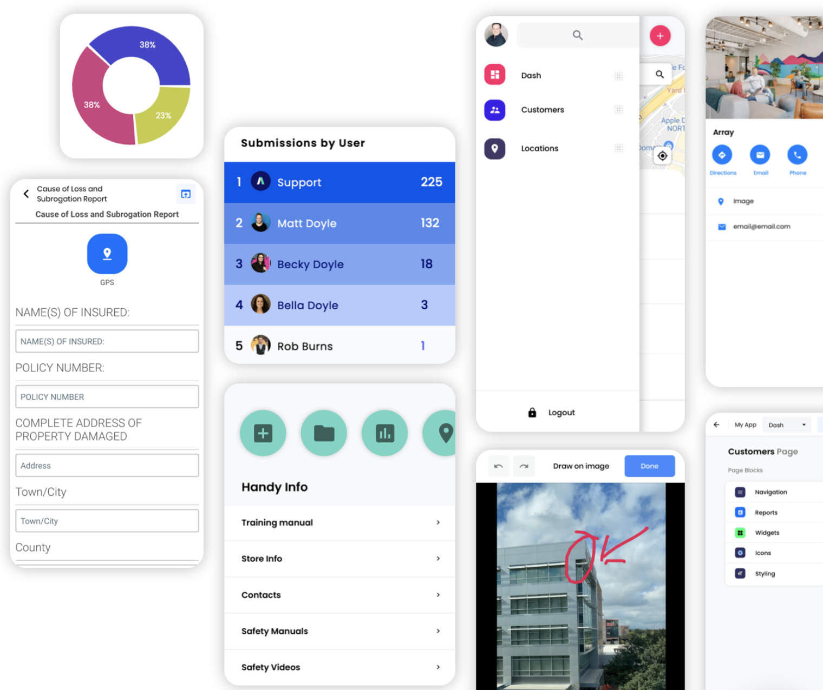
Array
Array’s mobile forms let you collect information from any
location quickly, easily and securely. With smart automation
and offline functionality
BA Assignments
IOS App
Signature forms and build your own recaps/surveys/etc
Pricing: TBD, they are able to do monthly pricing

Slide 36
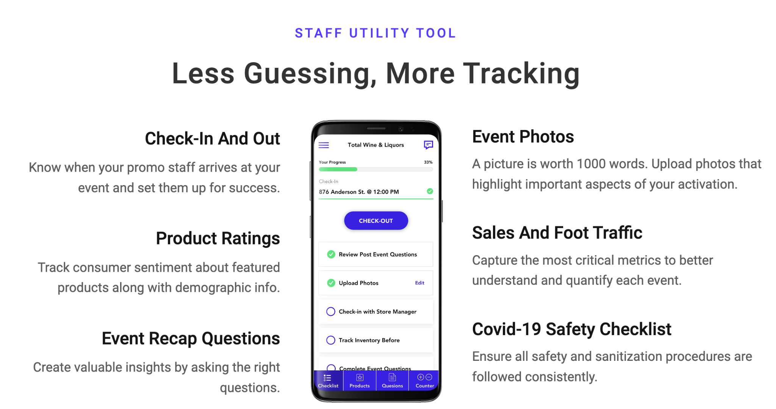
Samppoll
Could build something custom for $50k
They previously built out their software for field marketing, however closed it in 2020. They have all the functionality we are looking for, would just require the 50k to start it up again, custom for Momentum
https://www.sampoll.co/recapp

Slide 37
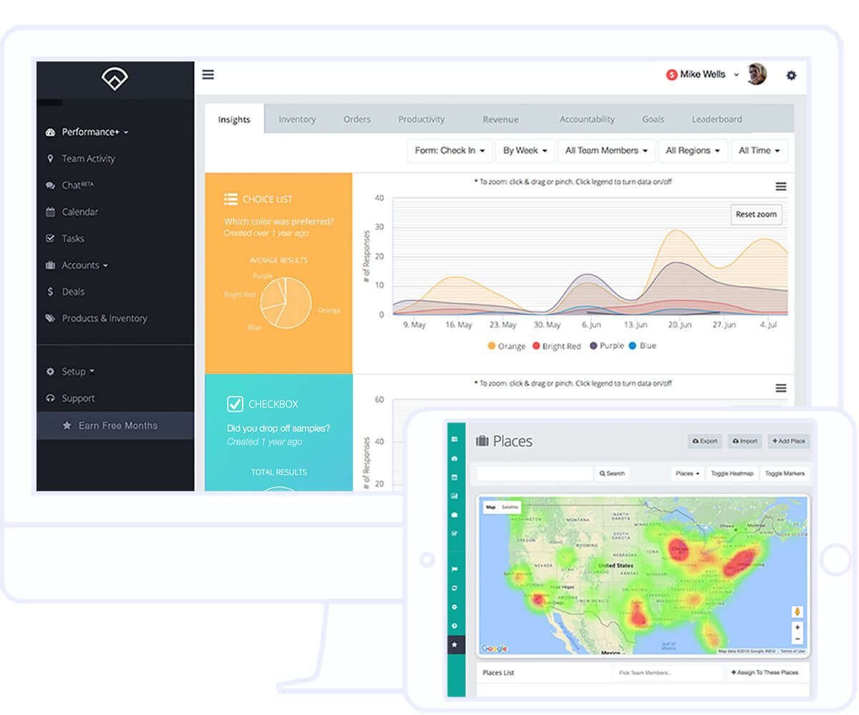
Outfield
https://www.outfieldapp.com/
We had a ton of convos with this company we really liked them however it is a big emphasis on field staff performance, rewarding people for check ins, recaps, etc. they have gamification specifically for field staff.
Features:
Bulk event uploads, mobile app for FMs, geolocation log in, custom recaps
**They are very very pushy and salesy
Pricing: 1 month - 69.99 per user per month; $59.99 /6 months; price is adjustable per program/length

Slide 38
Requirements
Platform must meet the following requirements
SCHEDULING
Schedule an event day or multi day events pre event date, ability to import a bulk upload of events or schedule one off (XP+BL)
Export all booked events for a month or date range (XP+BL)
Events classified by program, market and event type
Events scheduled with a date, location (address), and time attributed to them
Events assigned to a specific user or BA in the system to Recap that event
Staffing Agencies to assign/staff events
RECAPS
BA web app that updates real time, can start recap and edit before submitting
BA login permissions to only recap events that person is assigned to
Recaps should have logic to show specific questions based on answers
Recaps will ask a series of questions about event turn out, upload pictures/videos, etc. Should be able to have recaps specific to programs as we do not ask the same questions across all accounts or client
CLIENT
Client log in to only see events that have been recapped and approved
DATA
Recap data should export via API to Momentum Analytics dashboard (Bi)
All data reported to client comes from Momentum dashboard

